Slide 1

30 Days Java Full Stack Master Class
Day 2
CORE JAVA CONCEPTS

Slide 2
Eclipse and jdk installation
Installation of jdk and adt bundle.
Steps involved in setting the jdk path.
RightClick MyComputer->Properties
Next Click->Advanced System Settings
Click Environment variables.
Click new
Write the variable name as path
Copy the jdk path till bin folder
Paste the path of bin folder in the variable value.
Click on the OK button.
Click on the OK button.

Slide 3
Eclipse installation
Download Eclipse
Unzip the Eclipse file.

Slide 4
CORE JAVA Concepts

Slide 5
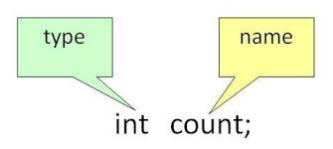
Java Variables
Variables are used to store values.
Variable Types determine the memory required to store that variable.

Slide 6
Exercise:
Write a program that stores a byte value and displays the result to the screen.

Slide 7
Java Identifiers
Variable names must be a unique name.
Unique names are called identifiers.
Identifiers can be small names(like a and b) or some other name which provides information about what that variable contains.
Consider the following example
int totalSum = 60;
String color = “Red”

Slide 8
Data Types in Java
Consider the following example
int num1 = 10; // Integer (whole number)
float numFloat = 10.55f; // Floating point number
char firstCh = ‘R'; //
Character boolean firstBl = true; // Boolean
String firstTxt = "Hello"; // String
There are two different Data types in Java
Primitive data types - byte, short, int, long, float, double, boolean and char come under primitive datatype
Non-primitive data types – String , arrays and classes come under non-primitive datatype

Slide 9
Exercise:
Write a program that concatenates two strings and displays the result to the screen.

Slide 10
Solution:
public class Combinestr {
public static void main(String[] args) {
/* The line Welcome To India will be printed at the output*/
String a1= “Beautiful";
String a2= “Garden";
String gname = a1 + a2;
System.out.println(gname);
}}

Slide 11
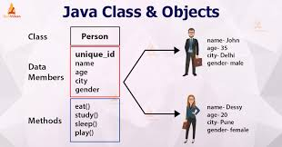
Classes and Objects In Java

Slide 12
EXAMPLE
public class Person {
public void drink(){
System.out.println("Drinking milk");
}
public static void main(String[] args) {
Person p1 = new Person();
String name = "John";
System.out.println(name);
p1.drink();
}
}

Slide 13
OUTPUT
John
Drinking milk

Slide 14
EXERCISE
Find the error in the following code.
public class Flower{
public void blossom{
System.out.println(“Flowers blossom);
}
public static void main(String[] args) {
Flower f1 = Flower();
String name = “Rose";
System.out.println(name);
f1. blossom()
}
}

Slide 15
solution
public class Flower{
public void blossom(){
System.out.println(“Flowers blossom");
}
public static void main(String[] args) {
Flower f1 = new Flower();
String name = “Rose";
System.out.println(name);
f1. blossom();
}
}

Slide 16
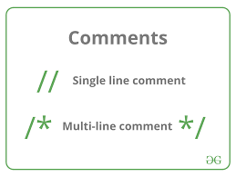
Java Comments(Single Line Comments)
Comments provide a brief description of the java code.
Comments can be added to a particular part of the program so that that part will not get executed while executing another part of the program.

Slide 17
SINGLE LINE COMMENTS
// Example Comment
System.out.println(“My First Comment");
As you can see , in the above example , a comment is included before the code.
In the below example , a comment is included at the end of the code.
System.out.println(“Second Comment"); // Comment at the end

Slide 18
Java Multi-line Comments
Multi-line comments are represented by /* and */.
Java cannot see anything written between /* and */.
Example Program :
public class Multicomment {
public static void main(String[] args) {
/* The line Welcome To India will be printed at the output*/
System.out.println("Welcome To India");
}
}

Slide 19
TasK
Exercise:
Write one sample program to illustrate single-line comment.
Find the error in the following program.
*/This is my first multi-line comment gets printed at the output*/ /
System.out.println(“This is my first multi-line comment");

Slide 20
SOLUTION
Solution:
public class Commexample{
public static void main(String[] args) {
//Sample Comment
System.out.println(“Welcome to the world of JavaProgramming");
System.out.println(“Learning Java is fun");//End of line Comment
}
}
Correct Code:
/*This is my first multi-line comment gets printed at the output*/
System.out.println(“This is my first multi-line comment");

Slide 21
What is Internship????
Learn
Practice
Verify
Get Certified
Grow

Slide 22
Pantech will make you to create 6 Projects in Java in 30 Days
Objective of this 30 Days Master Class

Slide 23
1 Month Internship in Java Full Stack
INTERNSHIP E-Certificate (30Days Internship on Java Full Stack)
Highly organized Video content
Download Project Files
Download PPTs
Assignments
Weekly Hackathons
Flexible Time.
Access Period: 60Days from the date of payment
Community or Forum Support

Slide 24
What You Will Get???
Project Files of Java
30 Days Learning Practice
Servlet concepts
+ Projects
Erasure Coding(Day 25)
Public Auditing(Day 26)
Counselling Management System(Day 27)
Software Puzzle(Day 28)
Crime Management System(Day 29)
Secure Multi-Owner Data Sharing(Day 30)
Project PPT
Video Class Access for 2 Months
Get chance to Enroll 1-Month Internship on demand

Slide 25
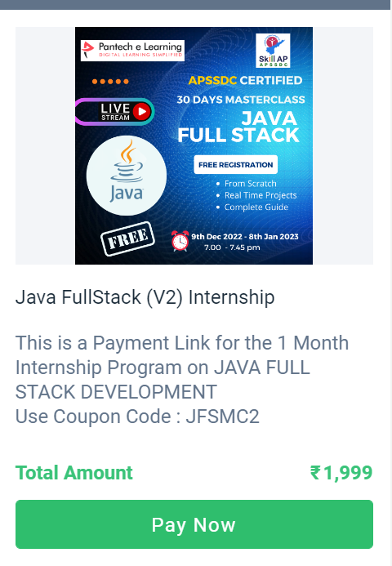
How to Enroll into 1 month Internship?
https://imjo.in/gHNkDr
REG FEE : Rs.1999 Rs.999
COUPON CODE : JFSMC2

